Slide 1
Met Data Analysis
COMP 4447 – Winter 2025
Gabe Barela & Reid Holben
Notes:
REID SLIDE: Introduction

Slide 2

Research Question
Examine the evolution of the Metropolitan Museum of Art’s collection via accession date and object history dates
See how well based on limited data can the museum’s classification system be replicated
Dataset from museum’s open access portal – last updated June 17th 2023. Minimal metadata available.
Notes:
REID SLIDE: This is the overview: evolution of the museum’s collection over time, seeing if classification system can be predicted.

Slide 3
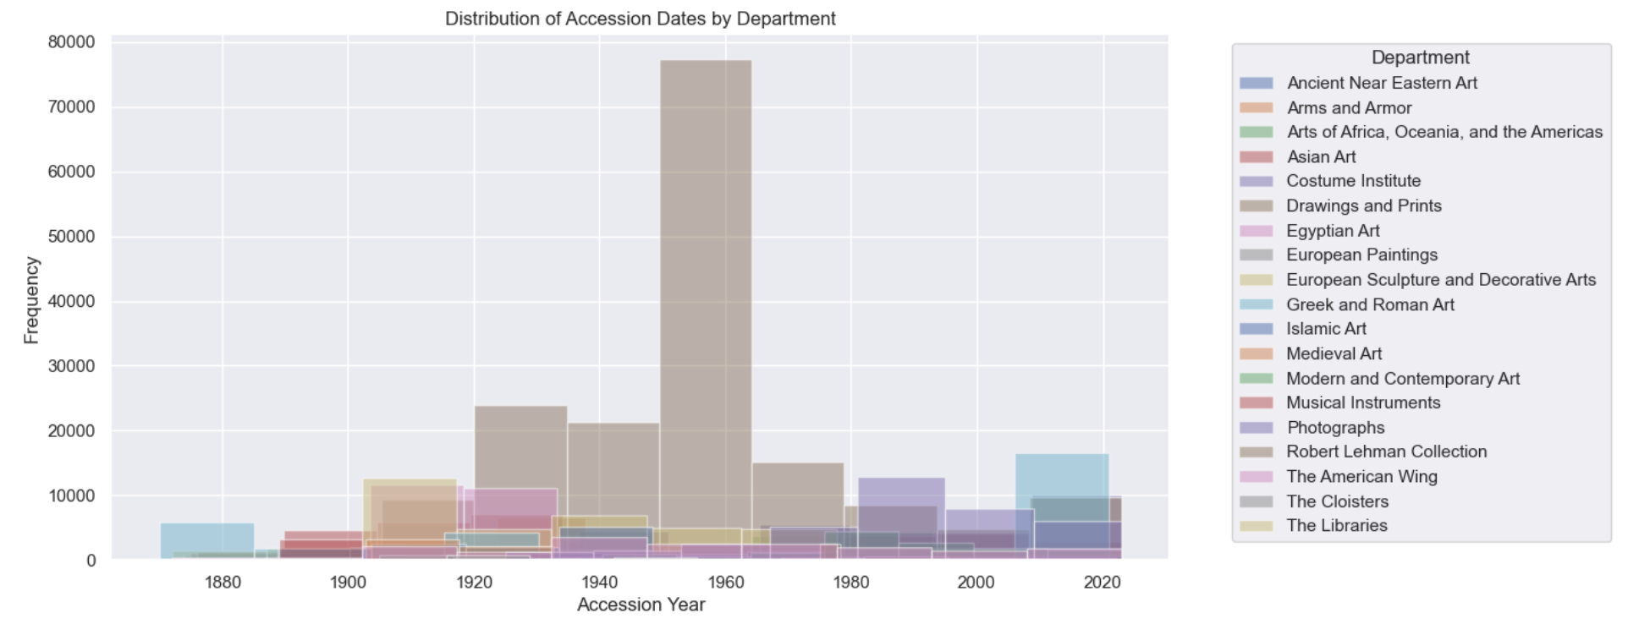
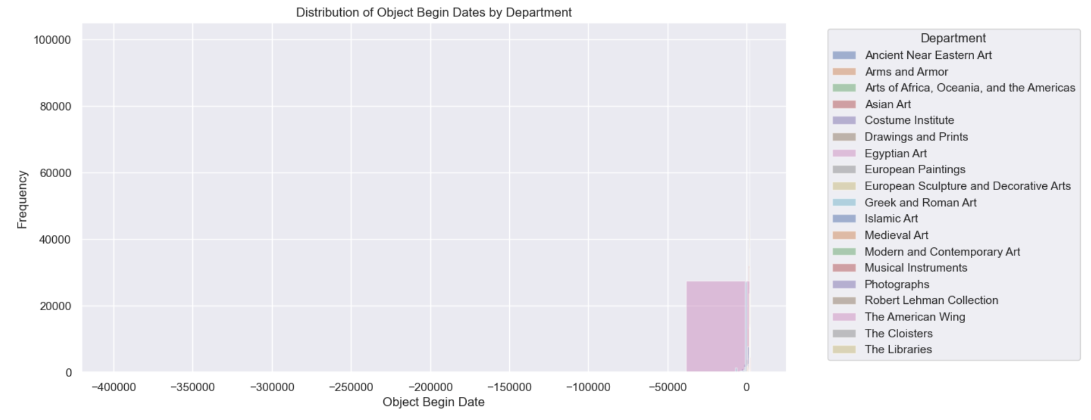
Data Exploration
There were several columns that were not numeric datatype. Mass conversions were needed to get messy data to align
i.e.: some dates as textual ranges, some as specific dates, others years
Once data was turned numeric, still issues with outliers skewing the results
Notes:
GABE SLIDE: Discuss initial feature engineering and need for data conversion

Slide 4
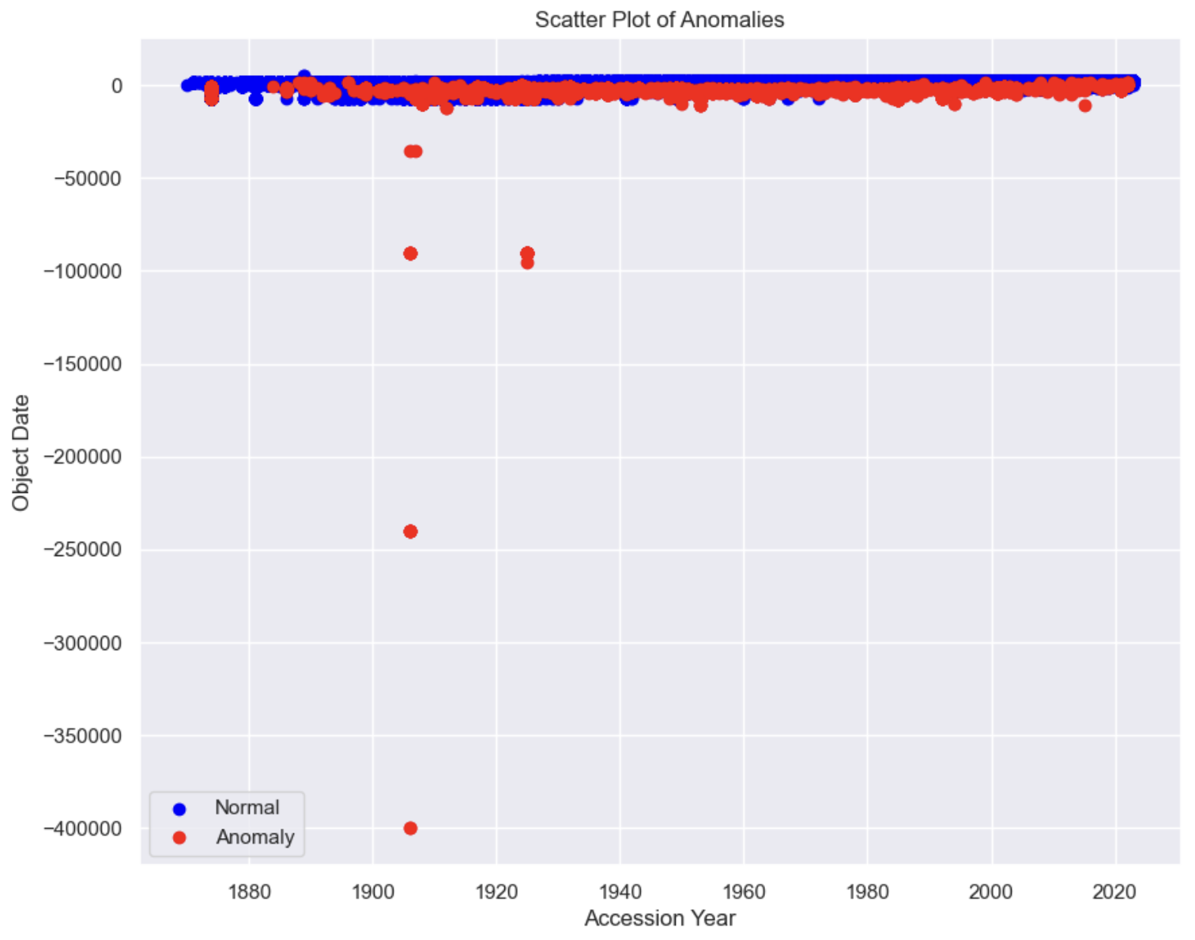
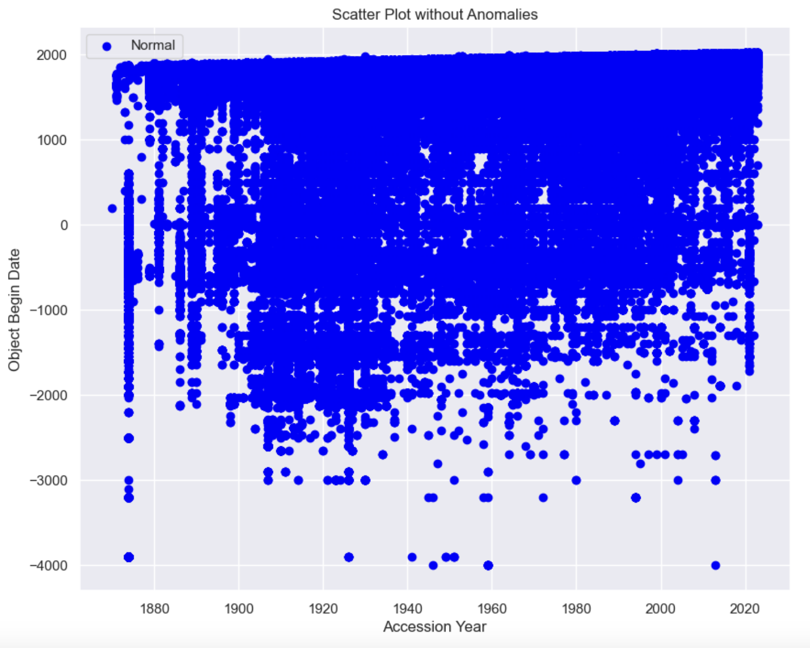
Outlier Detection
Notes:
GABE SLIDE: notes below on outliers. Anomalies pre and post: huge difference
Reasons for Data Removal
The data points flagged and removed as anomalies were identified based on several criteria:
Extreme Values:
Data points with values significantly higher or lower than the rest of the dataset. For example, 'Object Date' values far outside the typical range (e.g., -7000, 7000).
Inconsistent Data:
Rows with contradictory information, such as an 'Object Begin Date' that is later than the 'Object End Date'.
Rare Combinations:
Uncommon combinations of features that do not appear frequently in the dataset. For example, specific 'Department' values with unusual 'AccessionYear' values.
Missing or Default Values:
Rows with many missing values or default values (e.g., 0 or NaN) in features that usually contain meaningful data.

Slide 5

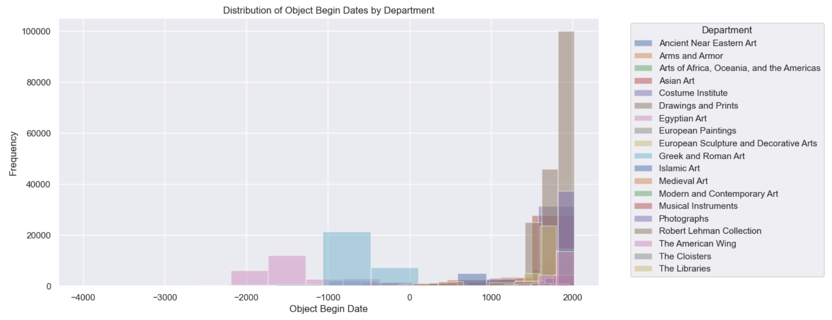
Post-Outliers
With only 1% of data removed post-isolation forest, there is a noticeable change in the legibility of some of the graphs
Especially Object Begin Date.
Following slide shows a scatter plot of object begin date and accession year
Notes:
GABE SLIDE: Post-Outliers you can see the object begin date graph is now significantly more legible.

Slide 6
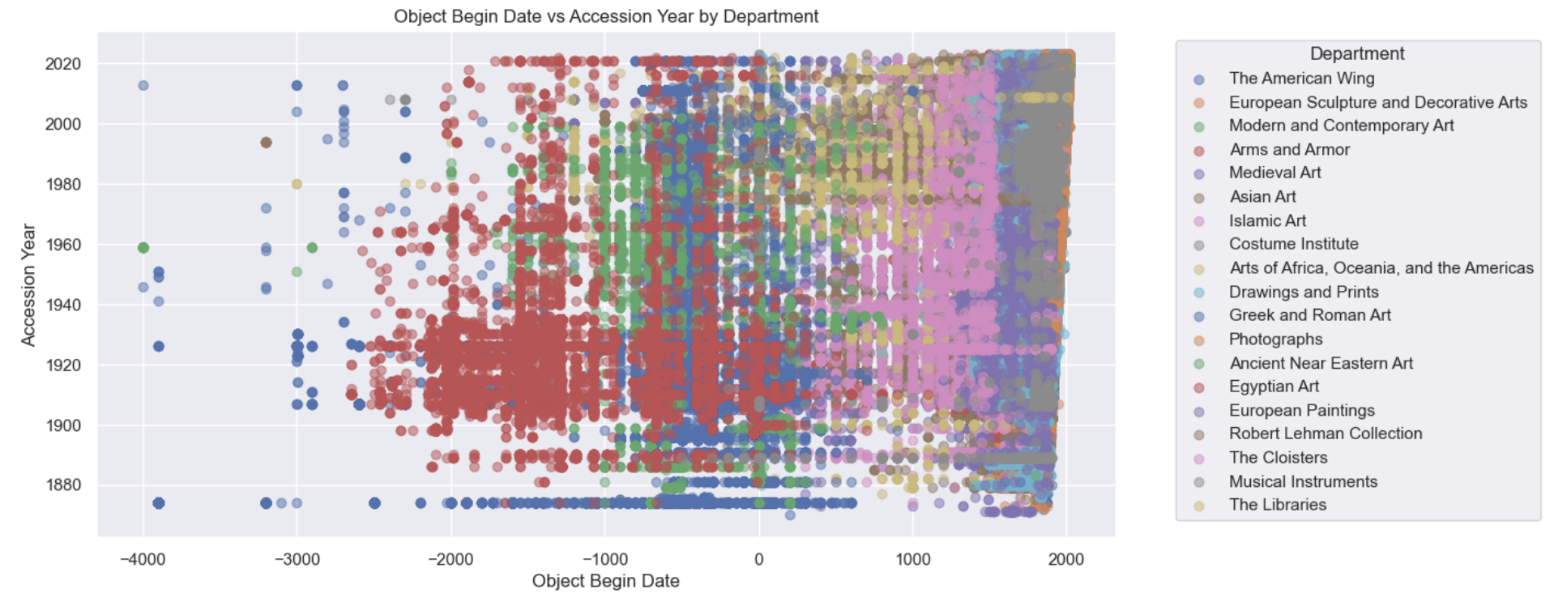
Notes:
GABE SLIDE: Here you can see where different departments are evolving over time

Slide 7
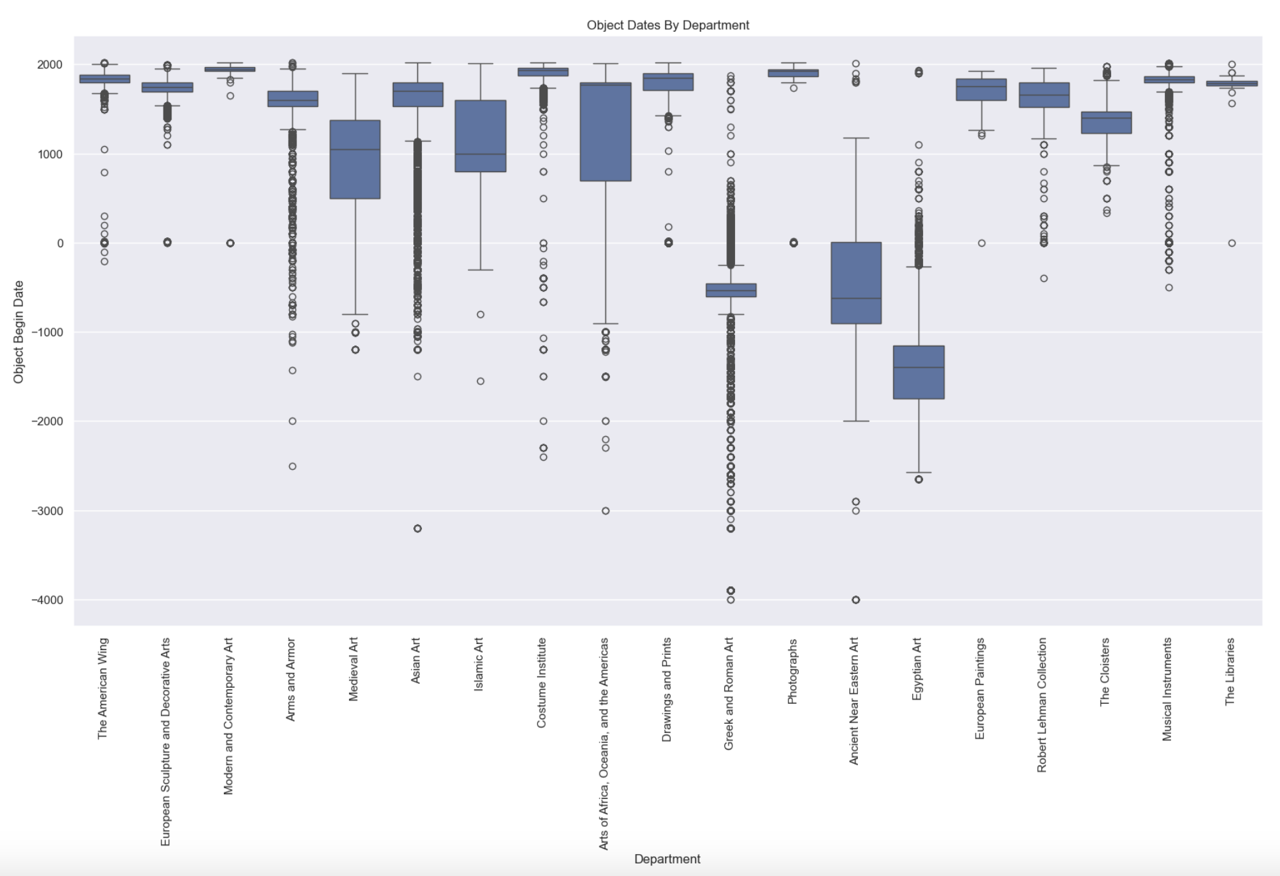
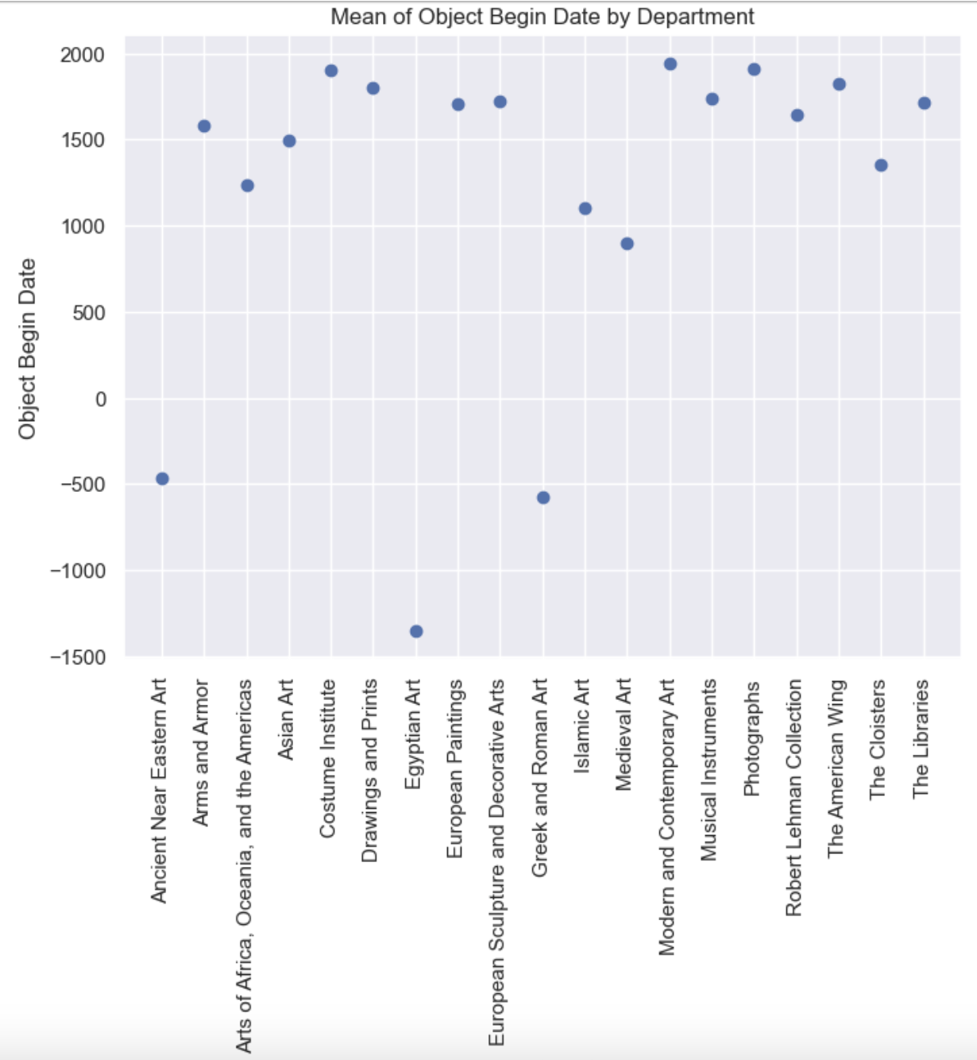
Notes:
REID SLIDE: These box plots especially are critical to analysis. This shows us the relative age per pieces in each department.

Slide 8
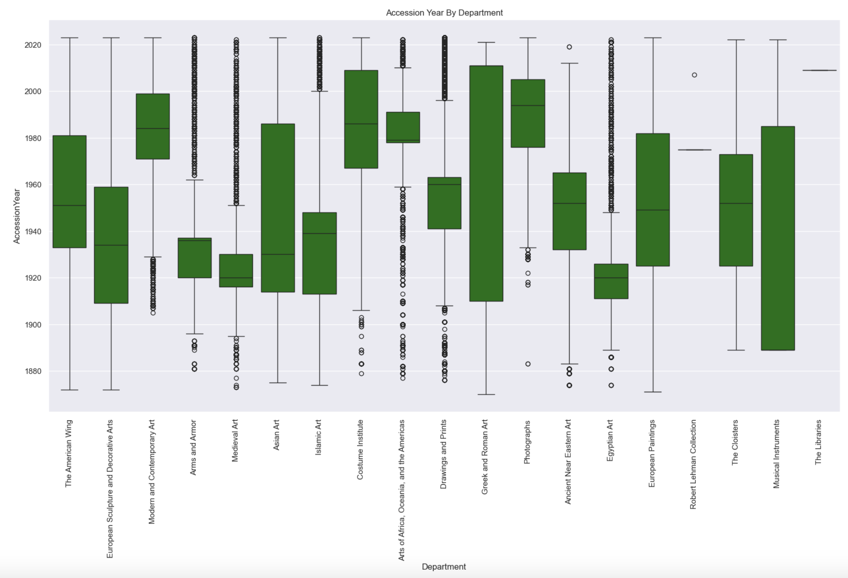
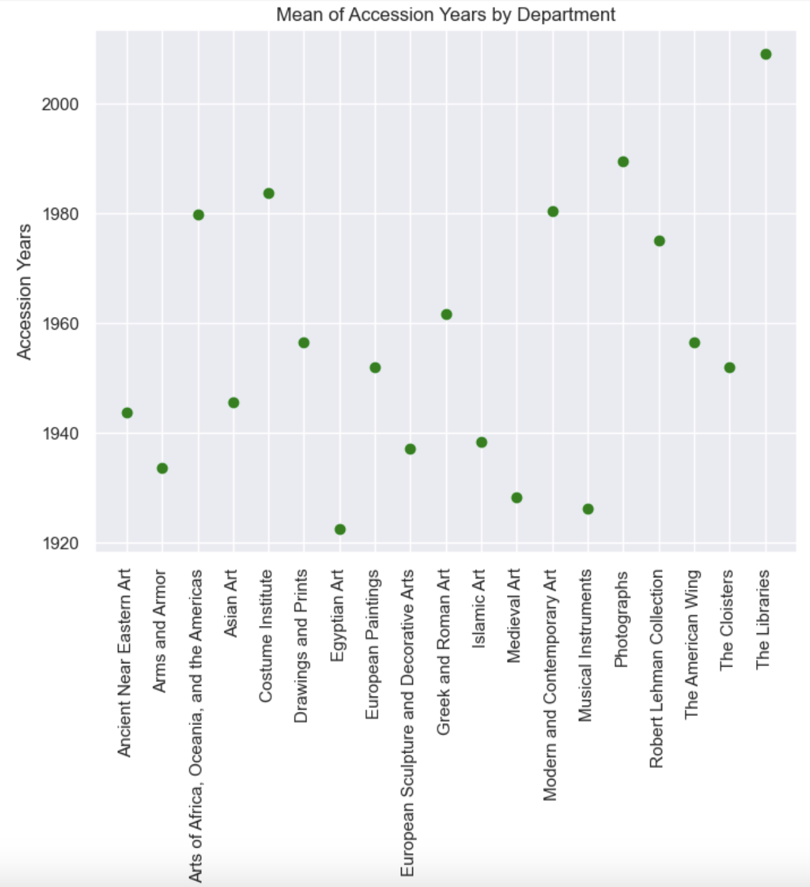
Notes:
REID SLIDE: This tells a great story about the collection. Some things have been consistent over time, some have faded or have become more prevalent now. From arms and armor to the costume institute!

Slide 9
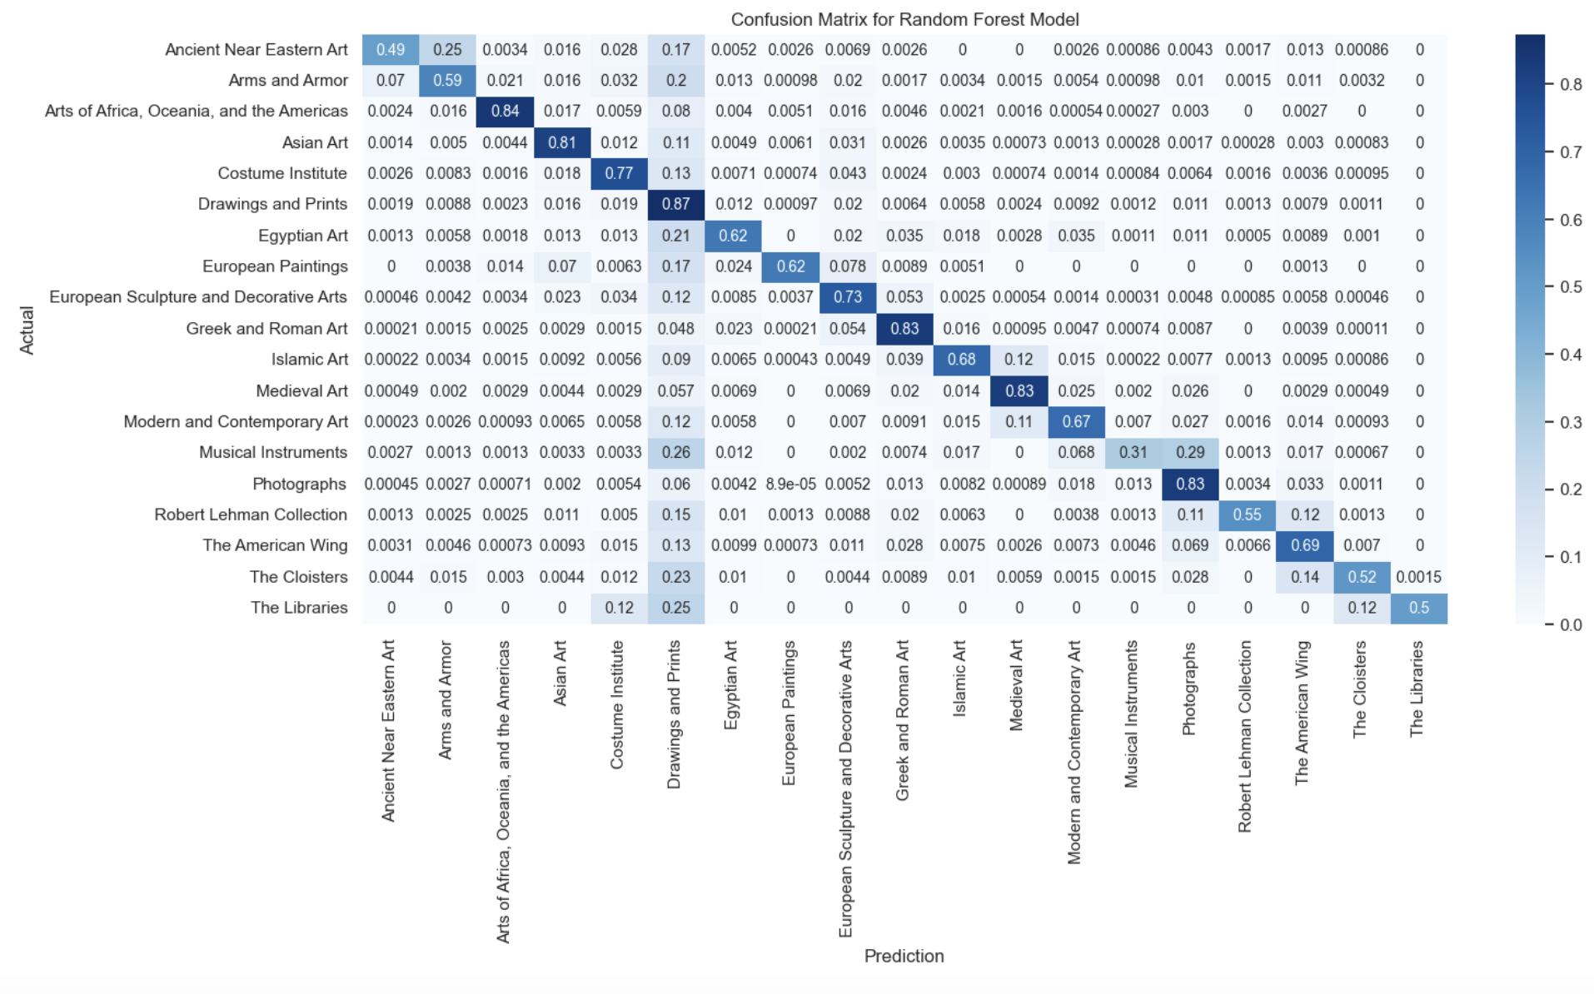
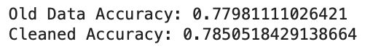
Modeling Potential
Decision Tree and Random Forest models applied to predict department classification
Random Forest always out-performed by 1%-2% margin
Anomalies improved model by minimal amount
Matrix itself reveals information on crossover
Notes:
REID SLIDE: Discuss using the random forest at the end. Makes sense Drawings and Prints could conceivably fit in any other category. Even t

Slide 10
Wrap-Up
The Met department classification system maps well to where models would predict objects to be.
The collection has moved to focusing more on American pieces and non-traditional art such as costuming, photography from traditional pieces
Feature engineering needed to improve messy data
Anomaly detection allows for cleaner analysis
GitHub Repo: https://github.com/gbarela83/COMP-4447-W25-MET_DATA_ANALYSIS
Notes:
REID SLIDE: Wrap-Up Time! Check in if Gabe has any other ideas

